Slide 1
CSCI 5448: FINAL PROJECT PRESENTATION (BUFF BEDS)
by
Gaurav Gandhi
Sarang Kulkarni
Akshit shah

Slide 2
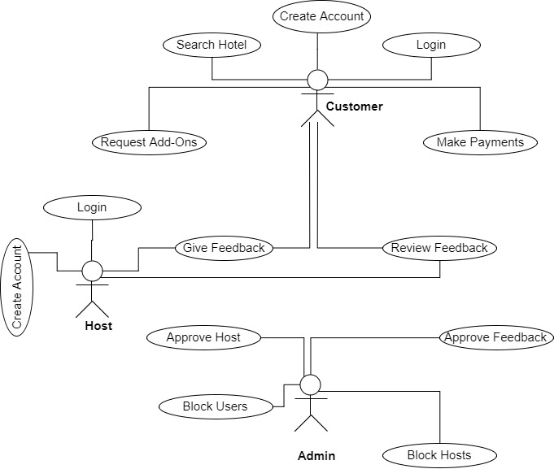
System Overview

Slide 3
Use Cases
UR-02 - Host can Apply for hotel/SignUp
UR -03 - End User can Login
UR – 05 - Customer can search and sort hotels or rooms
UR – 12 - Admin can approve request for new hosts/request for update information or block the end user

Slide 4
Use Cases Demo

Slide 5
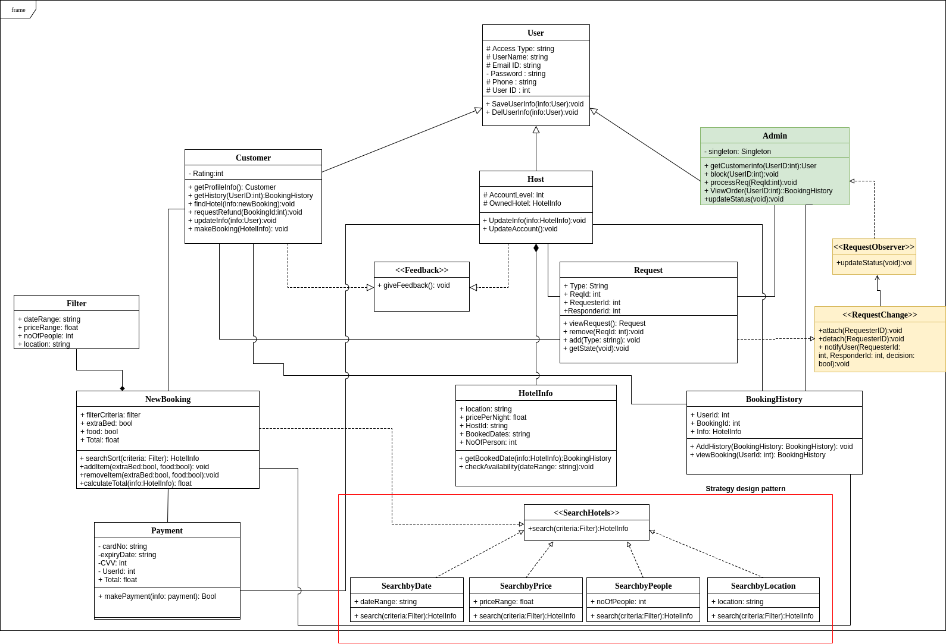
Strategy Design pattern

Slide 6
Observer Design Pattern

Slide 7
Singleton Design Pattern

Slide 8
Key Learnings
Planned to use Factory Design Pattern to create new users, but it returns one of the several classes instead of one specific task. So we decided to use constructors.
It is extremely important to spend a good amount of time on analyzing and designing the system before implementing it.
Software is naturally intangible, it is not easy to make the code portable and readable across the team. Sketching out the diagrams that enabled us pen our ideas
Refactoring of the design helped us to remove our flaws and make our design more simple.
We found the class diagram to be most useful as it clearly iterates software modules needed to be implemented along with attributes and methods. So, most of the implementation part was creating those same exact classes.
The design patterns helped us making our code more readable and easy to implement. This class has changed our approach in design a software and we would obviously implemented in our future designs.

Slide 9
Thank You

